Slide 1
CS 484
Introduction to Machine Learning
Week 9, March 18, 2021
Spring Semester 2021

Slide 2
Week 9 Agenda: Naïve Bayes
Directed Acyclic Graph
Bayesian Network
Naïve Bayes

Slide 3
Directed Acyclic Graph
Graph
A visual tool for displaying the assumed relationship among variables
Node
The variables are called nodes in the context of graphs
Edge
Represent the assumed causal relationships between two variables

Slide 4
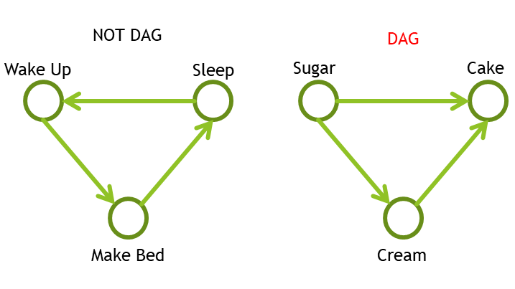
Directed Acyclic Graph
The edges are acyclic (i.e., not forming part of a cycle)
The causal relationships are assumed one-directional
No feedback relationships

Slide 5

Directed Acyclic Graph
Sunny
Cloudy
Rainy
If the grass is wet, what is the probability that it has rained before?
Weather Condition
Sprinkler On?
Rained Before?
Dry
Wet
Yes
No
Yes
No
Grass Condition

Slide 6
Directed Acyclic Graph
Weather Condition
Sunny
Cloudy
Rainy
Weather Condition affects Sprinkler On and Rained Before
Sprinkler On and Rained Before each individually affects Grass Condition
There is no relationship between Sprinkler On and Rained Before given Weather Condition
Sprinkler On?
Rained Before?
Dry
Wet
Yes
No
Yes
No
Grass Condition

Slide 7
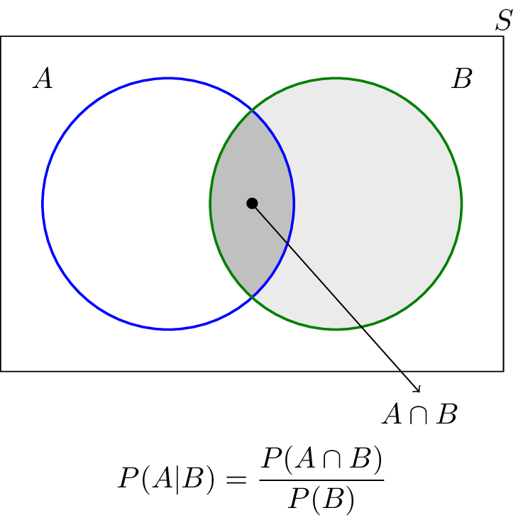
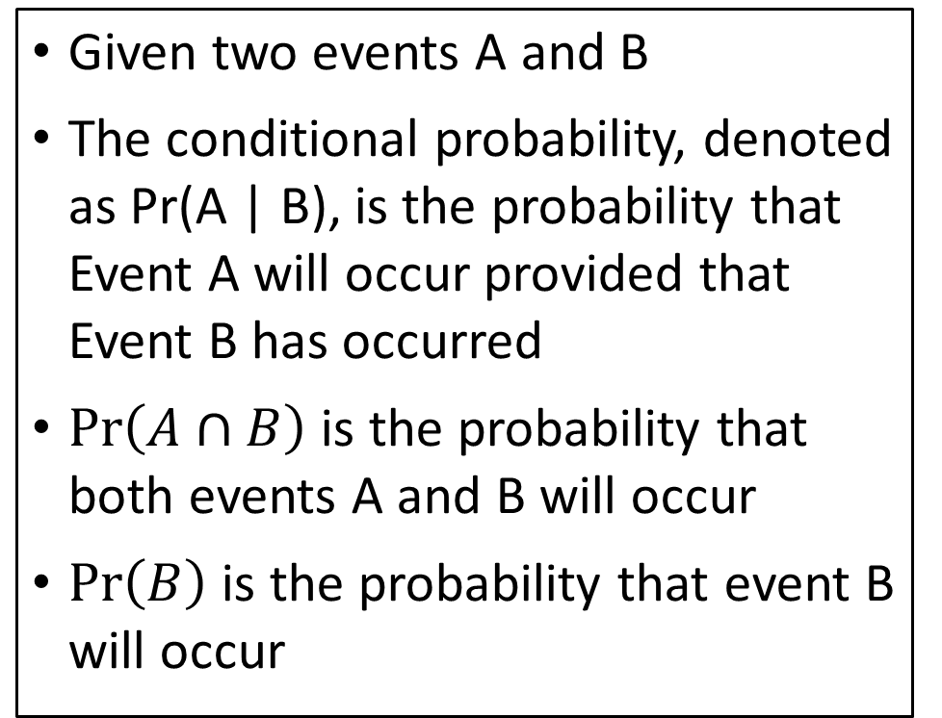
Conditional Probability
Given two events A and B
The conditional probability, denoted as Pr(A | B), is the probability that Event A will occur provided that Event B has occurred
$Pr\left(A∩B\right)$ is the probability that both events A and B will occur
$Pr\left(B\right)$ is the probability that event B will occur

Slide 8
Conditional Probability
Roll a Fair Dice
Ω = {1, 2, 3, 4, 5, 6}
A = {Odd Value} = {1, 3, 5}
B = {Value Divisible by 3} = {3, 6}
A ∩ B = {3}
Pr(A ∩ B) = 1 / 6
Pr(A) = 3 / 6
Pr(B|A) = (1/6) / (3/6) = 1/3
Pick a U(0,1) Random Number
Ω = {x: 0 ≤ x ≤ 1}
A = {2x < 1} = {x: 0 ≤ x < 0.5}
B = {3x > 1} = {x: 1/3 < x ≤ 1}
A ∩ B = {x: 1/3 < x < 1/2}
Pr(A ∩ B) = 1/2 – 1/3 = 1 / 6
Pr(A) = 1 / 2
Pr(B|A) = (1/6) / (1 / 2) = 1/3

Slide 9
Bayes’ Theorem
Pr(B|A) = Pr(A ∩ B) / Pr(A)
Pr(A ∩ B) = Pr(B|A) Pr(A)
Pr(A|B) = Pr(A ∩ B) / Pr(B)
➔ Pr(A ∩ B) = Pr(A|B) Pr(B)
Pr(A|B) Pr(B) =Pr(B|A) Pr(A)
Pr(A|B) = (Pr(B|A) Pr(A)) / Pr(B)
Roll a Fair Dice
Ω = {1, 2, 3, 4, 5, 6}
A = {Odd Value} = {1, 3, 5}
B = {Value Divisible by 3} = {3, 6}
Pr(B|A) = (1/6) / (3/6) = 1/3
Pr(A|B) = (1/3 * 3/6) / (2/6) = 1/2

Slide 10
Bayes’ Theorem
Pr(A|B) = (Pr(B|A) Pr(A)) / Pr(B)
Do we have to calculate Pr(B) explicitly?
Pr(B) = Pr(B ∩ Ω) where Ω is the universal set
Ω = A U (~A) where ~A is the complement set of A (i.e., everything but not in A)
B ∩ Ω = B ∩ (A U ~A)
A
B
A~
B ∩ Ω = B ∩ (A U ~A)
B = (B ∩ A) U (B ∩ ~A)
(B ∩ A) and (B ∩ ~A) are disjoint
Pr(B) = Pr(B ∩ A) + Pr(B ∩ ~A)

Slide 11
Bayes’ Theorem
Pr(B) = Pr(B ∩ A) + Pr(B ∩ ~A)
Pr(B ∩ A) = Pr(B|A) P(A)
Pr(B ∩ ~A) = Pr(B|~A) P(~A)
Pr(B) = Pr(B|A) P(A) + Pr(B|~A) P(~A)
Pr(A|B) = ( Pr(B|A) Pr(A) ) / ( Pr(B|A) P(A) + Pr(B|~A) P(~A) )
P(~A) = 1 – P(A)

Slide 12
Bayesian Network
A Bayesian network is a directed acyclic graphical model
It represents (1) probability relationships, and (2) conditional independence structure among the random variables
A Bayesian network is a family of classification algorithms for
Naïve Bayes
Tree-augmented Naïve Bayes (TAN)
Parent-child Bayesian Network
Markov Blanket

Slide 13
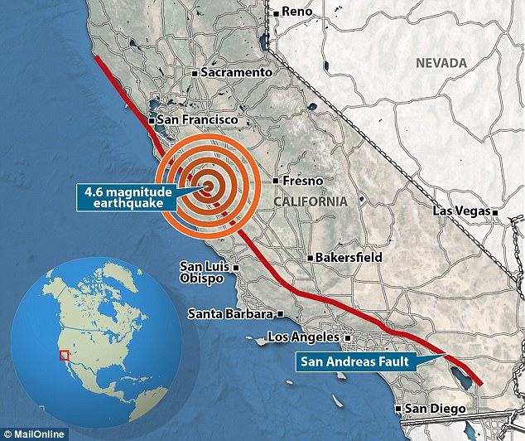
Bayesian Network Example
Russell and Norvig (2010). Artificial Intelligence: A Modern Approach, Third Edition. New Jersey: Pearson.
Suppose you live in an area (e.g., San Francisco Bay) where earthquakes are not uncommon

Slide 14





Bayesian Network Example
Your house has an alarm system against burglary, and the alarm system can be set off occasionally by an earthquake.
You have two neighbors, Mary and John, who do not know each other. If they hear the alarm, they might or might not call you.

Slide 15
Bayesian Network Example
The events are
Has Burglary?
Has Earthquake?
Did Alarm Sound?
Did John call?
Did Mary call?

Slide 16
Bayesian Network Example
The probabilities are either assigned or observed.
Earthquake and Burglary are assumed independent
Mary and John independently decide whether to call you
Whether Mary or John calls is conditionally dependent only on the state of the alarm.
The purpose of their calls is to inform you that your alarm has sounded, and not to tell you the cause.
You are responsible to find out the cause.

Slide 17
Bayesian Network Example
The joint probability of the events (B, E, A, J, and M) is Pr(B, E, A, J, M)
The Bayes’ Theorem: Pr(B, E, A, J, M) = Pr(J, M|B, E, A) * Pr(B, E, A)
Since Mary and John are assumed independent: Pr(J, M|B, E, A) = Pr(J|B, E, A) × Pr(M|B, E, A)
Bayesian Network: Pr(J|B, E, A) = Pr(J|A) Pr(M|B, E, A) = Pr(M|A)

Slide 18
Bayesian Network Example
Bayes’ Theorem: Pr(B, E, A) = Pr(A|B, E) * Pr(B, E)
Burglary and Earthquake are assumed independent: Pr(B, E) = Pr(B) * Pr(E).
Finally, Pr(B, E, A, J, M) = Pr(J, M|B, E, A) × Pr(B, E, A) = Pr(J|B, E, A) × Pr(M|B, E, A) × Pr(B, E, A) = Pr(J|A) × Pr(M|A) × Pr(A|B, E) × Pr(B) × Pr(E)

Slide 19
Bayesian Network Example
The network structure together with the conditional probability distributions completely determines the Bayesian network model.
Finally, Pr(B, E, A, J, M) = Pr(J, M|B, E, A) × Pr(B, E, A) = Pr(J|B, E, A) × Pr(M|B, E, A) × Pr(B, E, A) = Pr(J|A) × Pr(M|A) × Pr(A|B, E) × Pr(B) × Pr(E)

Slide 20
Bayesian Network Example: Scenario 1
Suppose you are at work:
The house is being burglarized (B = True)
There is no earthquake (E = False)
Neither John nor Mary calls (J = False and M = False)
What is the probability that the alarm went off (A = True)?
The probability is Pr(A = T|B = T, E = F, J = F, M = F) = Pr(A|B,~E, ~J, ~M) = Pr(B, ~E, A, ~J, ~M) / Pr(B, ~E, ~J, ~M)

Slide 21
Bayesian Network Example: Scenario 1
Pr(B, ~E, A, ~J, ~M) = Pr(~J|A) × Pr(~M|A) × Pr(A|B, ~E) × Pr(B) × Pr(~E) = (1 – 0.9) × (1 - 0.7) × (0.94) × (0.01) × (1 – 0.02) = 0.000276360
Pr(B, ~E, ~A, ~J, ~M) = Pr(~J|~A) × Pr(~M|~A) × Pr(~A|B, ~E) × Pr(B) × Pr(~E) = (1 – 0.05) × (1 - 0.01) × (1 – 0.94) × (0.01) × (1 – 0.02) = 0.000553014
Pr(B, ~E, ~J, ~M) = Pr(B, ~E, A, ~J, ~M) + Pr(B, ~E, ~A, ~J, ~M) = 0.000276360 + 0.000553014 = 0.000829374

Slide 22
Bayesian Network Example: Scenario 1
Suppose you are at work, the house is being burglarized (B = True), there is no earthquake (E = False), neither John nor Mary calls to say your alarm is ringing (J = False and M = False).
The probability that the alarm went off (A = True) is Pr(A = T|B = T, E = F, J = F, M = F) = Pr(A|B,~E, ~J, ~M) = Pr(B, ~E, A, ~J, ~M) / Pr(B, ~E, ~J, ~M) = 0.000276360 / 0.000829374 = 0.333215172
In summary, the conditional probability of the alarm having gone off in this situation is about 0.33.

Slide 23
Bayesian Network Example: Scenario 2
Suppose you are at work:
The house is burglarized (B = True)
There is no earthquake (E = False)
Mary called to say your alarm is ringing (M = True)
John did not call (J = False)
What is the probability that the alarm went off (A = True)?
The probability is Pr(A = T|B = T, E = F, J = F, M = T) = Pr(A|B,~E, ~J, M) = Pr(B, ~E, A, ~J, M) / Pr(B, ~E, ~ J, M)

Slide 24
Bayesian Network Example: Scenario 2
Pr(B, ~E, A, ~J, M) = Pr(~J|A) × Pr(M|A) × Pr(A|B, ~E) × Pr(B) * Pr(~E) = (1 – 0.9) × (0.7) × (0.94) × (0.01) × (1 – 0.02) = 0.000644840
Pr(B, ~E, ~A, ~J, M) = Pr(~J|~A) × Pr(M|~A) × Pr(~A|B, ~E) × Pr(B) × Pr(~E) = (1 – 0.05) × 0.01 × (1 – 0.94) × (0.01) × (1 – 0.02) = 0.000005586
Pr(B, ~E, ~J, M) = Pr(B, ~E, A, ~J, M) + Pr(B, ~E, ~A, ~J, M) = 0.00064484 + 0.000005586 = 0.000650426

Slide 25
Bayesian Network Example: Scenario 2
Suppose you are at work, the house is burglarized (B = True), there is no earthquake (E = False), your neighbor Mary calls to say your alarm is ringing (M = True), but neighbor John doesn’t call (J = False). What is the probability that the alarm went off (A = True)?
The probability is Pr(A = T|B = T, E = F, J = F, M = T) = Pr(A|B,~E, ~J, M) = Pr(B, ~E, A, ~J, M) / Pr(B, ~E, ~J, M) = 0.000644840 / 0.000650426 = 0.991411782
In summary, the conditional probability of the alarm having gone off in this situation is about 0.99.

Slide 26
Bayesian Network Example: Pr(A = True)
What is the overall probability that the alarm went off (A = True)?
The probability is Pr(A) = P(A,B,E) + P(A,~B,E) + P(A,B,~E) + P(A,~B,~E)
= Pr(A|B,E) × Pr(B,E) + Pr(A|~B,E) × Pr(~B,E) + Pr(A|B,~E) × Pr(B,~E) + Pr(A|~B,~E) × Pr(~B,~E) = Pr(A|B,E) × Pr(B) × Pr(E) + Pr(A|~B,E) × Pr(~B) × Pr(E) + Pr(A|B,~E) × Pr(B) × Pr(~E) + Pr(A|~B,~E) × Pr(~B) × Pr(~E) = 0.95 × 0.01 × 0.02 + 0.29 × (1-0.01) × 0.02 + 0.94 × 0.01 ×(1-0.02) + 0.0001 × (1-0.01) × (1-0.02) = 0.01524102

Slide 27
Bayesian Network Example: Summary
Scenario 1: When Mary calls but John did not:
Pr(A = T|B = T, E = F, J = F, M = T) = 0.99 > 0.02 = Pr(A = T)
I can surely classify that the alarm did go off.
Action: I should then contact the police to check on my house.
Scenario 2: When both Mary and John did not call:
Pr(A = T|B = T, E = F, J = F, M = F) = 0.33 > 0.02 = Pr(A = T)
This is not a negligible probability.
Action: I may consider subscribing to some monitoring services too.

Slide 28
Naïve Bayes Overview
A Naïve Bayes is a particular Bayesian Network.
There is an edge from the nominal target variable to each predictor
Categorical or interval predictors are allowed.
The predictors are assumed to be mutually independent conditional on the target variable. This is the Naïve part.
y
x₁
x₂
x₃
x₄
x₅

Slide 29
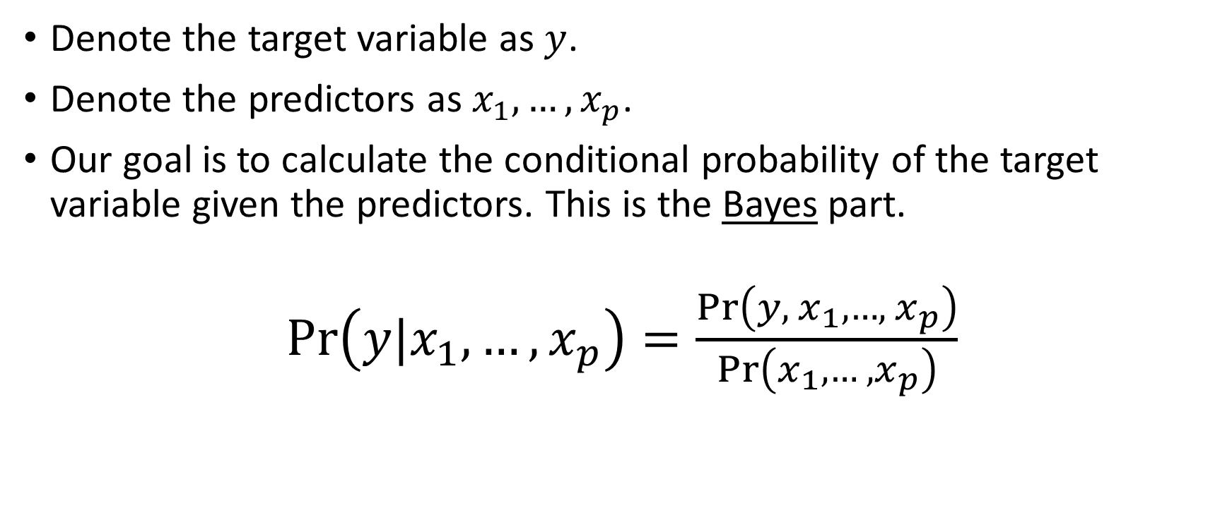
Naïve Bayes: Theory
Denote the target variable as $y$.
Denote the predictors as $x_{1},…,x_{p}$.
Our goal is to calculate the conditional probability of the target variable given the predictors. This is the Bayes part.
$Pr\left(y|x_{1},…,x_{p}\right)=\frac{Pr\left(y,{ x}_{1}, …,{ x}_{p}\right)}{Pr\left(x_{1}, …, x_{p}\right)}$

Slide 30
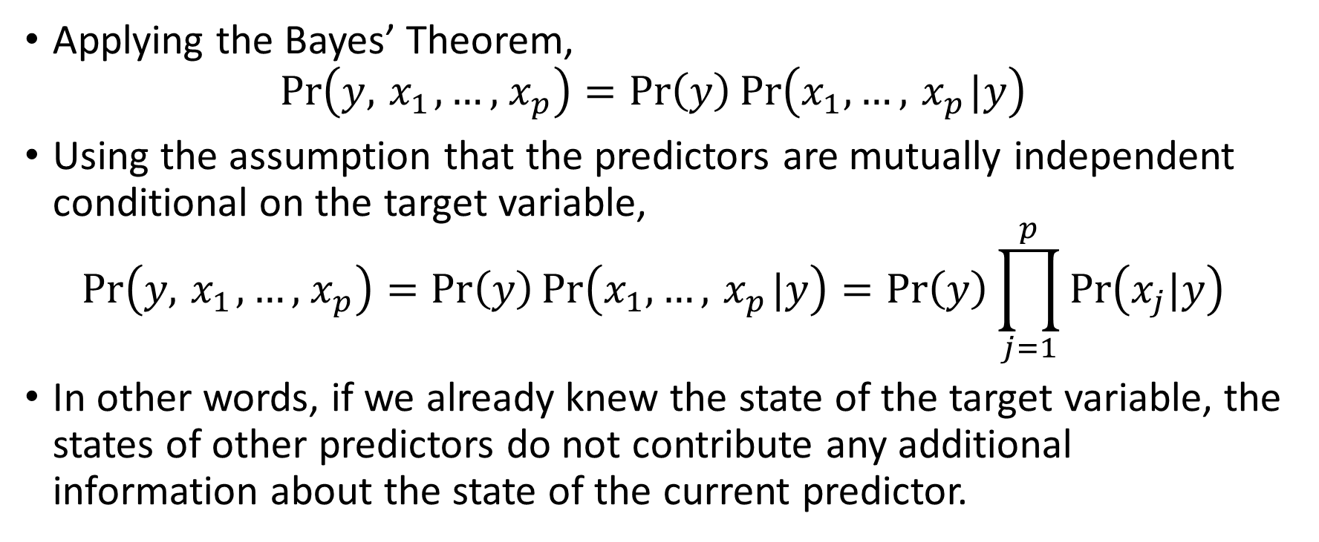
Naïve Bayes: Theory
Applying the Bayes’ Theorem,
$$Pr\left(y,{ x}_{1}, …,{ x}_{p}\right)=Pr\left(y\right)\operatorname{Pr}\left(x_{1}, …,{ x}_{p}|y\right)$$
Using the assumption that the predictors are mutually independent conditional on the target variable,
$$Pr\left(y,{ x}_{1}, …,{ x}_{p}\right)=Pr\left(y\right)\operatorname{Pr}\left(x_{1}, …,{ x}_{p}|y\right)=Pr\left(y\right)\prod_{j=1}^{p}{Pr\left(x_{j}|y\right)}$$
In other words, if we already knew the state of the target variable, the states of other predictors do not contribute any additional information about the state of the current predictor.

Slide 31
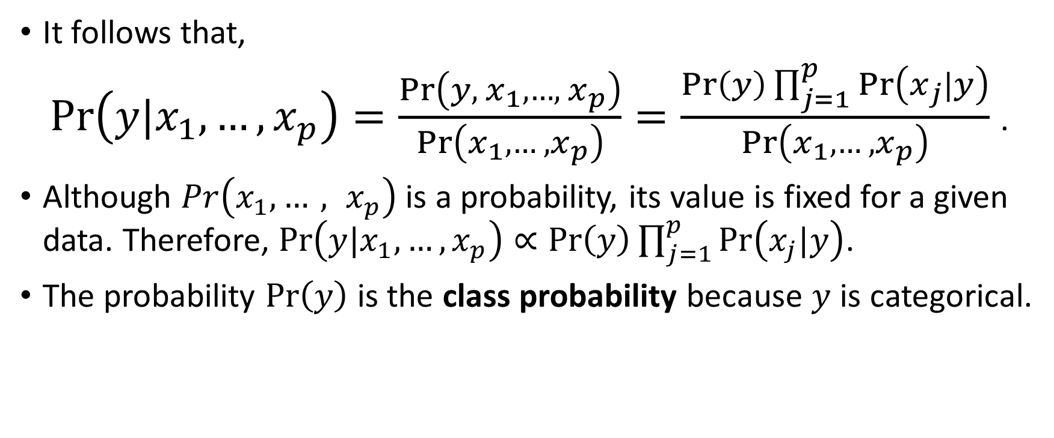
Naïve Bayes: Theory
It follows that,
$Pr\left(y|x_{1},…,x_{p}\right)=\frac{Pr\left(y,{ x}_{1}, …,{ x}_{p}\right)}{Pr\left(x_{1}, …, x_{p}\right)}=\frac{Pr\left(y\right)\prod_{j=1}^{p}{Pr\left(x_{j}|y\right)}}{Pr\left(x_{1}, …, x_{p}\right)}$ .
Although $Pr\left(x_{1}, …, x_{p}\right)$ is a probability, its value is fixed for a given data. Therefore, $Pr\left(y|x_{1},…,x_{p}\right)∝Pr\left(y\right)\prod_{j=1}^{p}{Pr\left(x_{j}|y\right)}$.
The probability $Pr\left(y\right)$ is the class probability because $y$ is categorical.

Slide 32
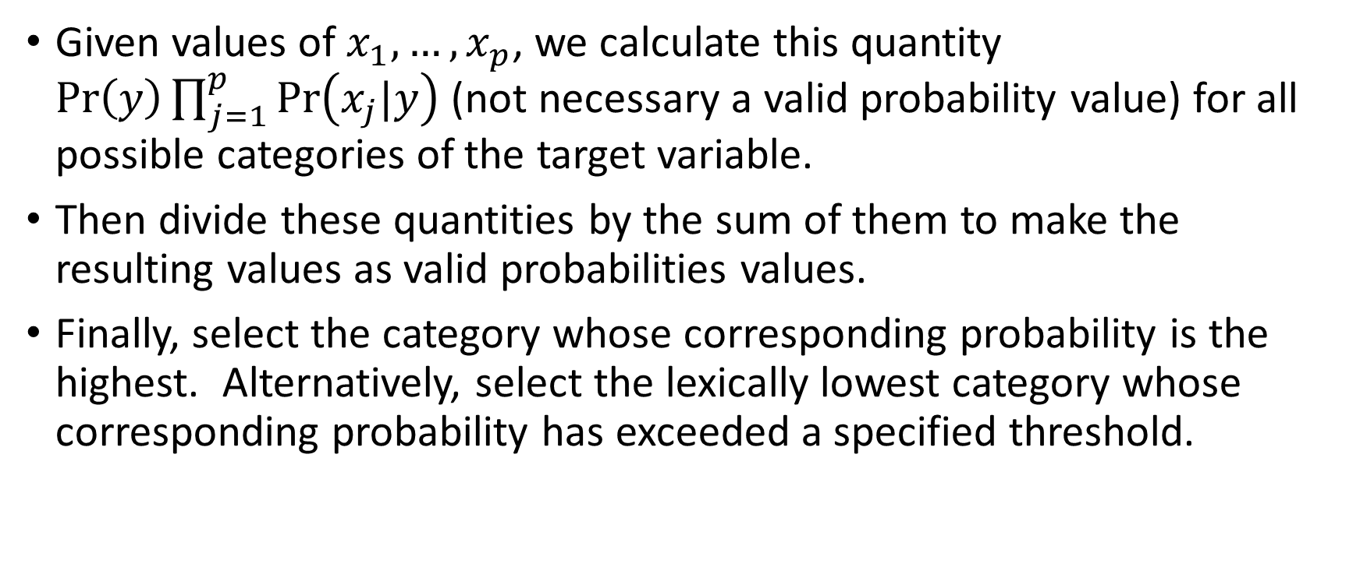
Naïve Bayes: Classifier
Given values of $x_{1},…,x_{p}$, we calculate this quantity $Pr\left(y\right)\prod_{j=1}^{p}{Pr\left(x_{j}|y\right)}$ (not necessary a valid probability value) for all possible categories of the target variable.
Then divide these quantities by the sum of them to make the resulting values as valid probabilities values.
Finally, select the category whose corresponding probability is the highest. Alternatively, select the lexically lowest category whose corresponding probability has exceeded a specified threshold.

Slide 33

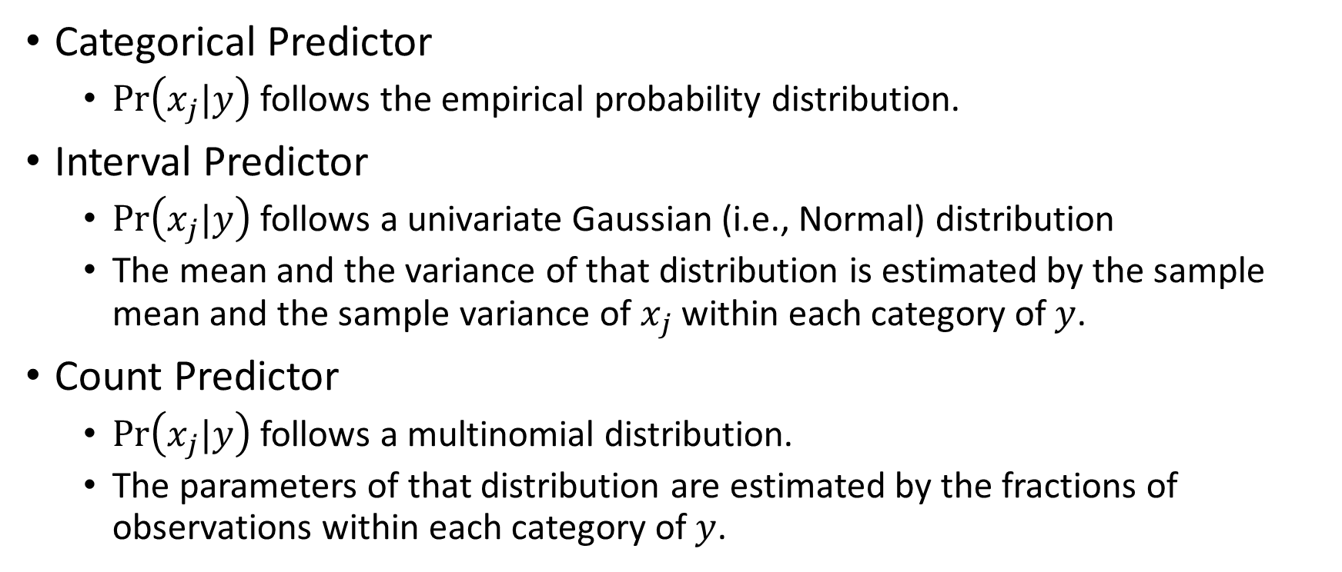
Naïve Bayes: Representing $Pr\left(x_{j}|y\right)$
Categorical Predictor
$Pr\left(x_{j}|y\right)$follows the empirical probability distribution.
Interval Predictor
$Pr\left(x_{j}|y\right)$follows a univariate Gaussian (i.e., Normal) distribution
The mean and the variance of that distribution is estimated by the sample mean and the sample variance of $x_{j}$within each category of $y$.
Count Predictor
$Pr\left(x_{j}|y\right)$follows a multinomial distribution.
The parameters of that distribution are estimated by the fractions of observations within each category of $y$.

Slide 34
Naïve Bayes: Customer Survey
You are working on a marketing campaign to promote the E-Billing service to bank customers.
You need to build the profiles of customers who will register for the E-Billing service.
You have access to a recent Customer Survey Data which contains information about 4,952 customers.

Slide 35
Naïve Bayes: Structure
Behavioral Theory:
A person’s aptitude (e.g., genes) to embrace E-Billing may also exemplifies in the person’s gender, the choice of credit card (spending vs. saving), and the career path (work/life balance).
Ebilling Yes / No
CreditCard
Gender
JobCategory
American Express Discover MasterCard
Others
Visa
Female Male
Agriculture
Crafts
Labor
Professional
Sales
Service

Slide 36
Naïve Bayes: Customer Survey
# Define a function to visualize the percent of a particular target category by a nominal predictor
def RowWithColumn (
rowVar, # Row variable
columnVar, # Column predictor
show = 'ROW'): # Show ROW fraction, COLUMN fraction, or BOTH table
countTable = pandas.crosstab(index = rowVar, columns = columnVar, margins = False, dropna = True)
print("Frequency Table: \n", countTable)
print( )
if (show == 'ROW' or show == 'BOTH'):
rowFraction = countTable.div(countTable.sum(1), axis='index')
print("Row Fraction Table: \n", rowFraction)
print( )
if (show == 'COLUMN' or show == 'BOTH'):
columnFraction = countTable.div(countTable.sum(0), axis='columns')
print("Column Fraction Table: \n", columnFraction)
print( )
return
Week 9 EBilling Naive Bayes.py

Slide 37
Customer Survey: Crosstabulation
EBilling | Count | Class Probability
No | 3,221 | 0.6504
Yes | 1,731 | 0.3496
Week 9 EBilling Naive Bayes.py
Count | Credit Card
Ebilling | American Express | Discover | MasterCard | Others | Visa | Total
No | 591 | 788 | 815 | 173 | 854 | 3,221
Yes | 390 | 543 | 369 | 48 | 381 | 1,731
Row Fraction | Credit Card
EBilling | American Express | Discover | MasterCard | Others | Visa | Total
No | 0.1835 | 0.2446 | 0.2530 | 0.0537 | 0.2651 | 1.0000
Yes | 0.2253 | 0.3137 | 0.2132 | 0.0277 | 0.2201 | 1.0000

Slide 38
Customer Survey: Crosstabulation
Count | Gender
EBilling | Female | Male | Total
No | 1,595 | 1,626 | 3,221
Yes | 895 | 836 | 1,731
Row Fraction | Gender
EBilling | Female | Male | Total
No | 0.4952 | 0.5048 | 1.0000
Yes | 0.5170 | 0.4830 | 1.0000
Week 9 EBilling Naive Bayes.py

Slide 39
Customer Survey: Crosstabulation
Week 9 EBilling Naive Bayes.py
Count | Job Category
EBilling | Agriculture | Crafts | Labor | Professional | Sales | Service | Total
No | 134 | 297 | 474 | 859 | 1,038 | 419 | 3,221
Yes | 78 | 152 | 206 | 512 | 588 | 195 | 1,731
Row Fraction | Job Category
EBilling | Agriculture | Crafts | Labor | Professional | Sales | Service | Total
No | 0.0416 | 0.0922 | 0.1472 | 0.2667 | 0.3223 | 0.1301 | 1.0000
Yes | 0.0451 | 0.0878 | 0.1190 | 0.2958 | 0.3397 | 0.1127 | 1.0000

Slide 40
Customer Survey: Conditional Probability
Conditional Probabilities of Ebilling = No given CreditCard, Gender, and JobCategory
Pr(EBilling = No|CreditCard = American Express, Gender = Female, JobCategory = Professional)
Pr(EBilling = No) × Pr(CreditCard = American Express|EBilling = No) × Pr(Gender = Female|EBilling = No) × Pr(JobCategory = Professional|EBilling = No)
= (3221/4952) × (591/3221) × (1595/3221) × (859/3221) = 0.015760836
EBilling | Count | Class Probability
No | 3,221 | 0.6504
Yes | 1,731 | 0.3496
Count | CreditCard
Ebilling | American Express | Discover | MasterCard | Others | Visa | Total
No | 591 | 788 | 815 | 173 | 854 | 3,221
Yes | 390 | 543 | 369 | 48 | 381 | 1,731
Count | Gender
EBilling | Female | Male | Total
No | 1,595 | 1,626 | 3,221
Yes | 895 | 836 | 1,731
Count | JobCategory
EBilling | Agriculture | Crafts | Labor | Professional | Sales | Service | Total
No | 134 | 297 | 474 | 859 | 1,038 | 419 | 3,221
Yes | 78 | 152 | 206 | 512 | 588 | 195 | 1,731

Slide 41
Customer Survey: Conditional Probability
Conditional Probabilities of Ebilling = Yes given CreditCard, Gender, and JobCategory
Pr(EBilling = Yes|CreditCard = American Express, Gender = Female, JobCategory = Professional)
Pr(EBilling = Yes) × Pr(CreditCard = American Express|EBilling = Yes) × Pr(Gender = Female|EBilling = Yes) × Pr(JobCategory = Professional|EBilling = Yes)
= (1731/4952) × (390/1731) × (895/1731) × (512/1731) = 0.012044335
EBilling | Count | Class Probability
No | 3,221 | 0.6504
Yes | 1,731 | 0.3496
Count | CreditCard
Ebilling | American Express | Discover | MasterCard | Others | Visa | Total
No | 591 | 788 | 815 | 173 | 854 | 3,221
Yes | 390 | 543 | 369 | 48 | 381 | 1,731
Count | Gender
EBilling | Female | Male | Total
No | 1,595 | 1,626 | 3,221
Yes | 895 | 836 | 1,731
Count | JobCategory
EBilling | Agriculture | Crafts | Labor | Professional | Sales | Service | Total
No | 134 | 297 | 474 | 859 | 1,038 | 419 | 3,221
Yes | 78 | 152 | 206 | 512 | 588 | 195 | 1,731

Slide 42
Customer Survey: Conditional Probability
Recap the results
Pr(EBilling = No|CreditCard = American Express, Gender = Female, JobCategory = Professional) ∝ 0.015760836
➔ Pr(EBilling = No|CreditCard = American Express, Gender = Female, JobCategory = Professional) = C * 0.015760836 where C is the proportional constant
Pr(EBilling = Yes|CreditCard = American Express, Gender = Female, JobCategory = Professional) ∝ 0.012044335
➔ Pr(EBilling = Yes|CreditCard = American Express, Gender = Female, JobCategory = Professional) = C * 0.012044335 where C is the proportional constant

Slide 43
Customer Survey: Conditional Probability
Recap the results
Since Ebilling is either No or Yes, then Pr(EBilling = No|CreditCard = American Express, Gender = Female, JobCategory = Professional) + Pr(EBilling = Yes|CreditCard = American Express, Gender = Female, JobCategory = Professional) = 1
Therefore 1 = C * 0.015760836 + C * 0.01 2044335 = C * 0.027805171
Hence, C = 1 / 0.027805171.

Slide 44
Customer Survey: Conditional Probability
Convert to Valid Probability Values
Put C = 1 / 0.027805171
Pr(EBilling = No|CreditCard = American Express, Gender = Female, JobCategory = Professional) = C * 0.015760836 = 0.015760836 / 0.027805171 = 0.566831107
Pr(EBilling = Yes|CreditCard = American Express, Gender = Female, JobCategory = Professional) = C * 0.012044335 = 0.012044335 / 0.027805171 = 0.433168893

Slide 45
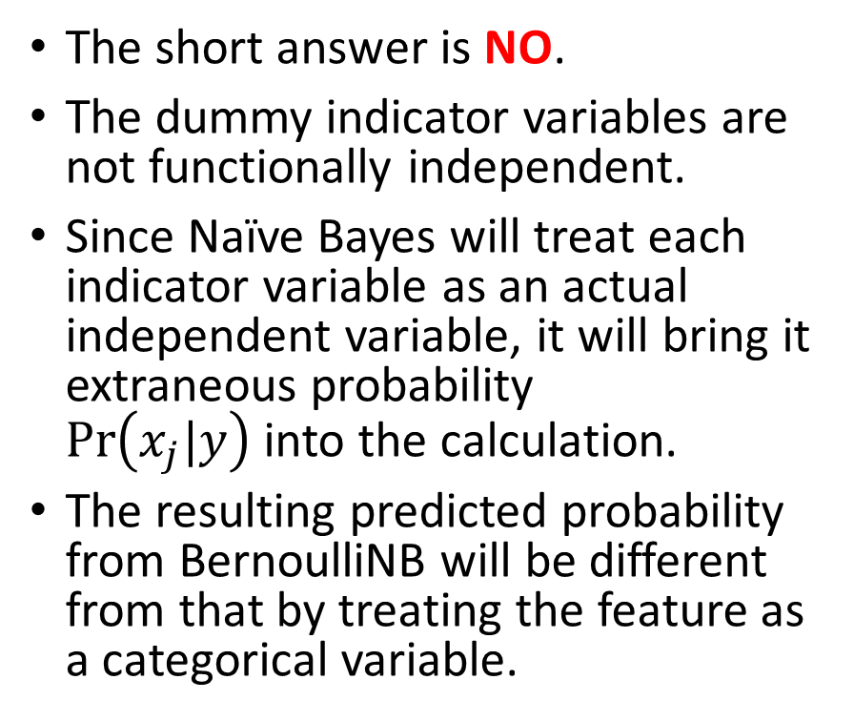
Caution About naive_bayes.BernoulliNB
Since the naive_bayes.BernoulliNB function can handle binary features that are coded 0 or 1
Pandas.GetDummies can create 0/1 indicator variables for categorical features
Can we use the BernoulliNB function for categorical features?
The short answer is NO.
The dummy indicator variables are not functionally independent.
Since Naïve Bayes will treat each indicator variable as an actual independent variable, it will bring it extraneous probability $Pr\left(x_{j}|y\right)$into the calculation.
The resulting predicted probability from BernoulliNB will be different from that by treating the feature as a categorical variable.

Slide 46
Instead Use naive_bayes. CategoricalNB
Training vectors X
Assume each feature of X is from a different categorical distribution.
Require that all categories of each feature are represented by integers 0, …, n - 1, where n is the total number of categories of a feature.
This can be achieved with the help of OrdinalEncoder.
Target vector y
Although documentation does not say whether integers 0, 1, … is required, we will use LabelEncoder too.

Slide 47
Customer Survey: Naïve Bayes
from sklearn import preprocessing, naive_bayes
labelEnc = preprocessing.LabelEncoder()
yTrain = labelEnc.fit_transform(subData['EBilling'])
yLabel = labelEnc.inverse_transform([0, 1])
uCreditCard = numpy.unique(subData['CreditCard'])
uGender = numpy.unique(subData['Gender'])
uJobCategory = numpy.unique(subData['JobCategory'])
featureCategory = [uCreditCard, uGender, uJobCategory]
featureEnc = preprocessing.OrdinalEncoder(categories = featureCategory)
xTrain = featureEnc.fit_transform(subData[['CreditCard', 'Gender', 'JobCategory']])
_objNB = naive_bayes.CategoricalNB(alpha = 1.0e-10)
thisModel = _objNB.fit(xTrain, yTrain)

Slide 48
Customer Survey: Naïve Bayes
print('Number of samples encountered for each class during fitting')
print(yLabel)
print(_objNB.class_count_)
print('\n')
print('Probability of each class:')
print(yLabel)
print(numpy.exp(_objNB.class_log_prior_))
print('\n’)
Number of samples encountered for each class during fitting
['No' 'Yes']
[3221. 1731.]
Probability of each class:
['No' 'Yes']
[0.65044426 0.34955574]

Slide 49
Customer Survey: Naïve Bayes
feature = ['CreditCard', 'Gender', 'JobCategory']
print('Number of samples encountered for each (class, feature) during fitting')
for i in range(3):
print('Feature: ', feature[i])
print(featureCategory[i])
print(_objNB.category_count_[i])
print('\n')
print('Empirical probability of features given a class, P(x_i|y)')
for i in range(3):
print('Feature: ', feature[i])
print(featureCategory[i])
print(numpy.exp(_objNB.feature_log_prob_[i]))
print('\n')

Slide 50
Customer Survey: Naïve Bayes
Number of samples encountered for each (class, feature) during fitting
Feature: CreditCard
['American Express' 'Discover' 'MasterCard' 'Others' 'Visa']
[[591. 788. 815. 173. 854.]
[390. 543. 369. 48. 381.]]
Feature: Gender
['Female' 'Male']
[[1595. 1626.]
[ 895. 836.]]
Feature: JobCategory
['Agriculture' 'Crafts' 'Labor' 'Professional' 'Sales' 'Service']
[[ 134. 297. 474. 859. 1038. 419.]
[ 78. 152. 206. 512. 588. 195.]]

Slide 51
Customer Survey: Naïve Bayes
Empirical probability of features given a class, P(x_i|y)
Feature: CreditCard
['American Express' 'Discover' 'MasterCard' 'Others' 'Visa']
[[0.18348339 0.24464452 0.25302701 0.05371003 0.26513505]
[0.22530329 0.31369151 0.21317158 0.02772964 0.22010399]]
Feature: Gender
['Female' 'Male']
[[0.49518783 0.50481217]
[0.51704217 0.48295783]]
Feature: JobCategory
['Agriculture' 'Crafts' 'Labor' 'Professional' 'Sales' 'Service']
[[0.04160199 0.09220739 0.14715927 0.26668736 0.32226017 0.13008382]
[0.04506066 0.08781051 0.11900635 0.29578278 0.33968804 0.11265165]]

Slide 52
Customer Survey: Naïve Bayes
# CreditCard = American Express, Gender = Female, JobCategory = Professional
xTest = featureEnc.transform([['American Express', 'Female', 'Professional']])
y_predProb = thisModel.predict_proba(xTest)
print('Predicted Probability: ', yLabel, y_predProb)
Predicted Probability: ['No' 'Yes'] [[0.56683111 0.43316889]]
C = 1 / 0.027805171
Pr(EBilling = No|CreditCard = American Express, Gender = Female, JobCategory = Professional) = C * 0.015760836 = 0.015760836 / 0.027805171 = 0.566831107
Pr(EBilling = Yes|CreditCard = American Express, Gender = Female, JobCategory = Professional) = C * 0.012044335 = 0.012044335 / 0.027805171 = 0.433168893

Slide 53

Nutrition Information Study
Are you taking any dietary supplements?
Is TV a primary source of information about nutrition?
Are magazines a primary source of information about nutrition?
Are friends a primary source of information about nutrition?
Is your doctor a primary source of information about nutrition?
1 = Yes
2 = No
1 = Yes
2 = No
1 = Yes
2 = No
1 = Yes
2 = No
Source: McKay, D. L., Houser, R. F., Blumberg, J. B., Goldberg, J. P. (2006). Nutrition information sources vary with education level in a population of older adults. Journal of the American Dietetic Association, 106, 1108-1111.
1 = Yes
2 = No
Week 9 Nutrition Naive Bayes.py

Slide 54
Nutrition Information: Binary Features
# Specify the roles
feature = ['tv', 'magazine', 'friends', 'doctor']
target = 'supps'
# Read the Excel file
nutrition = pandas.read_excel('C:\\IIT\\Machine Learning\\Data\\Nutrition_Information.xls',
sheet_name = 'Sheet1',
usecols = feature + [target])
nutrition = nutrition.dropna()
# Look at the row distribution
print(nutrition.groupby(target).size())
for pred in feature:
RowWithColumn(rowVar = nutrition[target], columnVar = nutrition[pred], show = 'ROW')
Week 9 Nutrition Naive Bayes.py

Slide 55
Naïve Bayes: Binary Features
supps | Count | Class Probability
Yes | 66 | 0.38150289
No | 107 | 0.61849711
Total | 173 | 1.0
supps: Are you taking any dietary supplements?
tv: Is TV a primary source of information about nutrition?
magazine: Are magazines a primary source of information about nutrition?
friends: Are friends a primary source of information about nutrition?
doctor: Is your doctor a primary source of information about nutrition?
Week 9 Nutrition Naive Bayes.py
Count | tv
supps | Yes | No | Total
Yes | 34 | 32 | 66
No | 51 | 56 | 107
Count | magazine
supps | Yes | No | Total
Yes | 42 | 24 | 66
No | 62 | 45 | 107
Count | friends
supps | Yes | No | Total
Yes | 22 | 44 | 66
No | 30 | 77 | 107
Count | doctor
supps | Yes | No | Total
Yes | 39 | 27 | 66
No | 68 | 39 | 107

Slide 56
Nutrition Information: Conditional Probability
supps | Count | Class Probability
Yes | 66 | 0.38150289
No | 107 | 0.61849711
Total | 173 | 1.0
Conditional Probabilities of supps = Yes given tv, magazine, friends, and doctor
Pr(supps = Yes|tv = Yes, magazine = Yes, friends = Yes, doctor = Yes)
Pr(supps = Yes) × Pr(tv = Yes |supps = Yes) × Pr(magazine = Yes|supps = Yes) × Pr(friends = Yes|supps = Yes) × Pr(doctor = Yes|supps = Yes)
= (66/173) × (34/66) × (42/66) × (22/66) × (39/66) = 0.0246341502253221
Count | tv
supps | Yes | No | Total
Yes | 34 | 32 | 66
No | 51 | 56 | 107
Count | magazine
supps | Yes | No | Total
Yes | 42 | 24 | 66
No | 62 | 45 | 107
Count | friends
supps | Yes | No | Total
Yes | 22 | 44 | 66
No | 30 | 77 | 107
Count | doctor
supps | Yes | No | Total
Yes | 39 | 27 | 66
No | 68 | 39 | 107

Slide 57
Nutrition Information: Conditional Probability
supps | Count | Class Probability
Yes | 66 | 0.38150289
No | 107 | 0.61849711
Total | 173 | 1.0
Conditional Probabilities of supps = No given tv, magazine, friends, and doctor
Pr(supps = No|tv = Yes, magazine = Yes, friends = Yes, doctor = Yes)
Pr(supps = No) × Pr(tv = Yes |supps = No) × Pr(magazine = Yes|supps = No) × Pr(friends = Yes|supps = No) × Pr(doctor = Yes|supps = No)
= (107/173) × (51/107) × (62/107) × (30/107) × (68/107) = 0.030436492074722
Count | tv
supps | Yes | No | Total
Yes | 34 | 32 | 66
No | 51 | 56 | 107
Count | magazine
supps | Yes | No | Total
Yes | 42 | 24 | 66
No | 62 | 45 | 107
Count | friends
supps | Yes | No | Total
Yes | 22 | 44 | 66
No | 30 | 77 | 107
Count | doctor
supps | Yes | No | Total
Yes | 39 | 27 | 66
No | 68 | 39 | 107

Slide 58
Nutrition Information: Conditional Probability
Recap the results
Pr(supps = Yes | tv = Yes, magazine = Yes, friends = Yes, doctor = Yes) ∝ 0.0246341502253221
Pr(supps = No | tv = Yes, magazine = Yes, friends = Yes, doctor = Yes) ∝ 0.030436492074722
The sum is 0.0246341502253221 + 0.030436492074722 = 0.0550706423000441

Slide 59
Nutrition Information: Conditional Probability
Convert to Valid Probability Values
Pr(supps = Yes | tv = Yes, magazine = Yes, friends = Yes, doctor = Yes) = 0.0246341502253221 / 0.0550706423000441 = 0.4473191014
Pr(supps = No | tv = Yes, magazine = Yes, friends = Yes, doctor = Yes) = 0.030436492074722 / 0.0550706423000441 = 0.5526808986

Slide 60
Nutrition Information: BernoulliNB
The features must take only 0 or 1 values
# Make the binary features take values 0 and 1 (was 2=No and 1=Yes)
nutrition[feature] = 2 - nutrition[feature]
xTrain = nutrition[feature].astype('category')
yTrain = nutrition[target].astype('category')
_objNB = naive_bayes.BernoulliNB(alpha = 1.e-10)
thisFit = _objNB.fit(xTrain, yTrain)
print('Probability of each class')
print(numpy.exp(thisFit.class_log_prior_))
print('Empirical probability of features given a class, P(x_i|y)')
print(numpy.exp(thisFit.feature_log_prob_))
print('Number of samples encountered for each class during fitting')
print(thisFit.class_count_)
print('Number of samples encountered for each (class, feature) during fitting')
print(thisFit.feature_count_)
Alpha is the additive (Laplace/Lidstone) smoothing parameter (0 for no smoothing).
Ideally, we want alpha = 0, but this is as small as the function allows.

Slide 61
Nutrition Information: BernoulliNB
Probability of each class
supps = No supps = Yes
[0.38150289 0.61849711]
Empirical probability of features given a class, P(x_i|y)
_ tv magazine friends doctor
supps = Yes [[0.51515152 0.63636364 0.33333333 0.59090909]
supps = No [0.47663551 0.57943925 0.28037383 0.63551402]]
Number of samples encountered for each class during fitting
[ 66. 107.]
Number of samples encountered for each (class, feature) during fitting
supps = Yes [[34. 42. 22. 39.] # tv magazine friends doctor
supps = No [51. 62. 30. 68.]]

Slide 62
Nutrition Information: BernoulliNB
# Create the all-possible combinations of the features' values
xTest = pandas.DataFrame(list(itertools.product([0,1],
repeat = len(feature))),
columns = feature)
# Score the xTest and append the predicted probabilities to the xTest
yTest_predProb = pandas.DataFrame(_objNB.predict_proba(xTest),
columns = ['P_suppsYes', 'P_suppsNo’])
yTest_score = pandas.concat([xTest, yTest_predProb], axis = 1)

Slide 63
Nutrition Information: Naïve Bayes
tv | magazine | friends | doctor | P_suppsYes | P_suppsNo
0 | 0 | 0 | 0 | 0.33938350 | 0.66061650
0 | 0 | 0 | 1 | 0.29853915 | 0.70146085
0 | 0 | 1 | 0 | 0.39733497 | 0.60266503
0 | 0 | 1 | 1 | 0.35324558 | 0.64675442
0 | 1 | 0 | 0 | 0.39486710 | 0.60513290
0 | 1 | 0 | 1 | 0.35089211 | 0.64910789
0 | 1 | 1 | 0 | 0.45575652 | 0.54424348
0 | 1 | 1 | 1 | 0.40959031 | 0.59040969
1 | 0 | 0 | 0 | 0.37475009 | 0.62524991
1 | 0 | 0 | 1 | 0.33178710 | 0.66821290
1 | 0 | 1 | 0 | 0.43476616 | 0.56523384
1 | 0 | 1 | 1 | 0.38920564 | 0.61079436
1 | 1 | 0 | 0 | 0.43223255 | 0.56776745
1 | 1 | 0 | 1 | 0.38675587 | 0.61324413
1 | 1 | 1 | 0 | 0.49417844 | 0.50582156
1 | 1 | 1 | 1 | 0.44731910 | 0.55268090

Slide 64
Nutrition Information: Naïve Bayes
Listen Only to your Doctor!
tv | magazine | friends | doctor | P_suppsYes | P_suppsNo
0 | 0 | 0 | 1 | 0.29853915 | 0.70146085
1 | 0 | 0 | 1 | 0.33178710 | 0.66821290
0 | 0 | 0 | 0 | 0.33938350 | 0.66061650
0 | 1 | 0 | 1 | 0.35089211 | 0.64910789
0 | 0 | 1 | 1 | 0.35324558 | 0.64675442
1 | 0 | 0 | 0 | 0.37475009 | 0.62524991
1 | 1 | 0 | 1 | 0.38675587 | 0.61324413
1 | 0 | 1 | 1 | 0.38920564 | 0.61079436
0 | 1 | 0 | 0 | 0.39486710 | 0.60513290
0 | 0 | 1 | 0 | 0.39733497 | 0.60266503
0 | 1 | 1 | 1 | 0.40959031 | 0.59040969
1 | 1 | 0 | 0 | 0.43223255 | 0.56776745
1 | 0 | 1 | 0 | 0.43476616 | 0.56523384
1 | 1 | 1 | 1 | 0.44731910 | 0.55268090
0 | 1 | 1 | 0 | 0.45575652 | 0.54424348
1 | 1 | 1 | 0 | 0.49417844 | 0.50582156
Decreasing P_suppsYNo

Slide 65
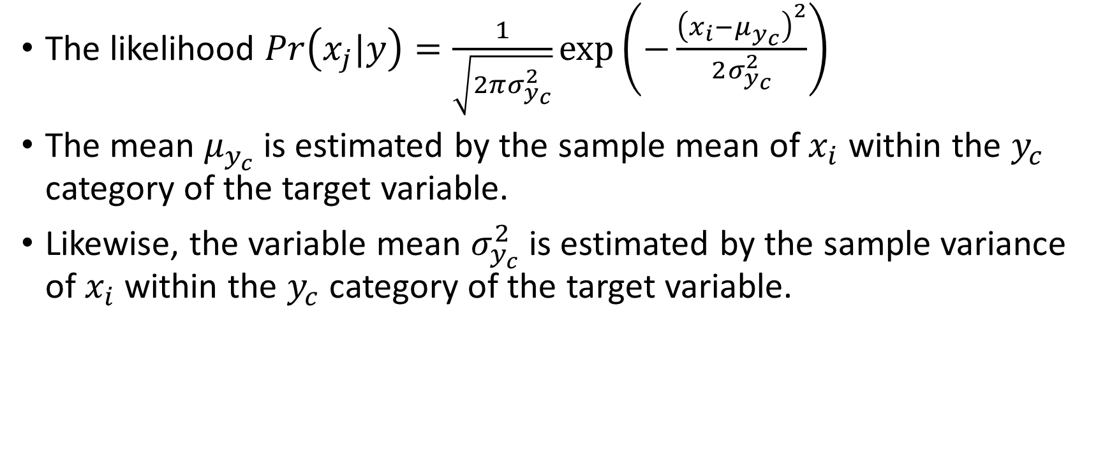
Gaussian Naïve Bayes
The likelihood $Pr\left(x_{j}|y\right)=\frac{1}{\sqrt{2πσ_{y_{c}}^{2}}}exp\left(−\frac{{\left(x_{i}−μ_{y_{c}}\right)}^{2}}{2σ_{y_{c}}^{2}}\right)$
The mean $μ_{y_{c}}$ is estimated by the sample mean of $x_{i}$ within the $y_{c}$ category of the target variable.
Likewise, the variable mean $σ_{y_{c}}^{2}$ is estimated by the sample variance of $x_{i}$ within the $y_{c}$ category of the target variable.

Slide 66
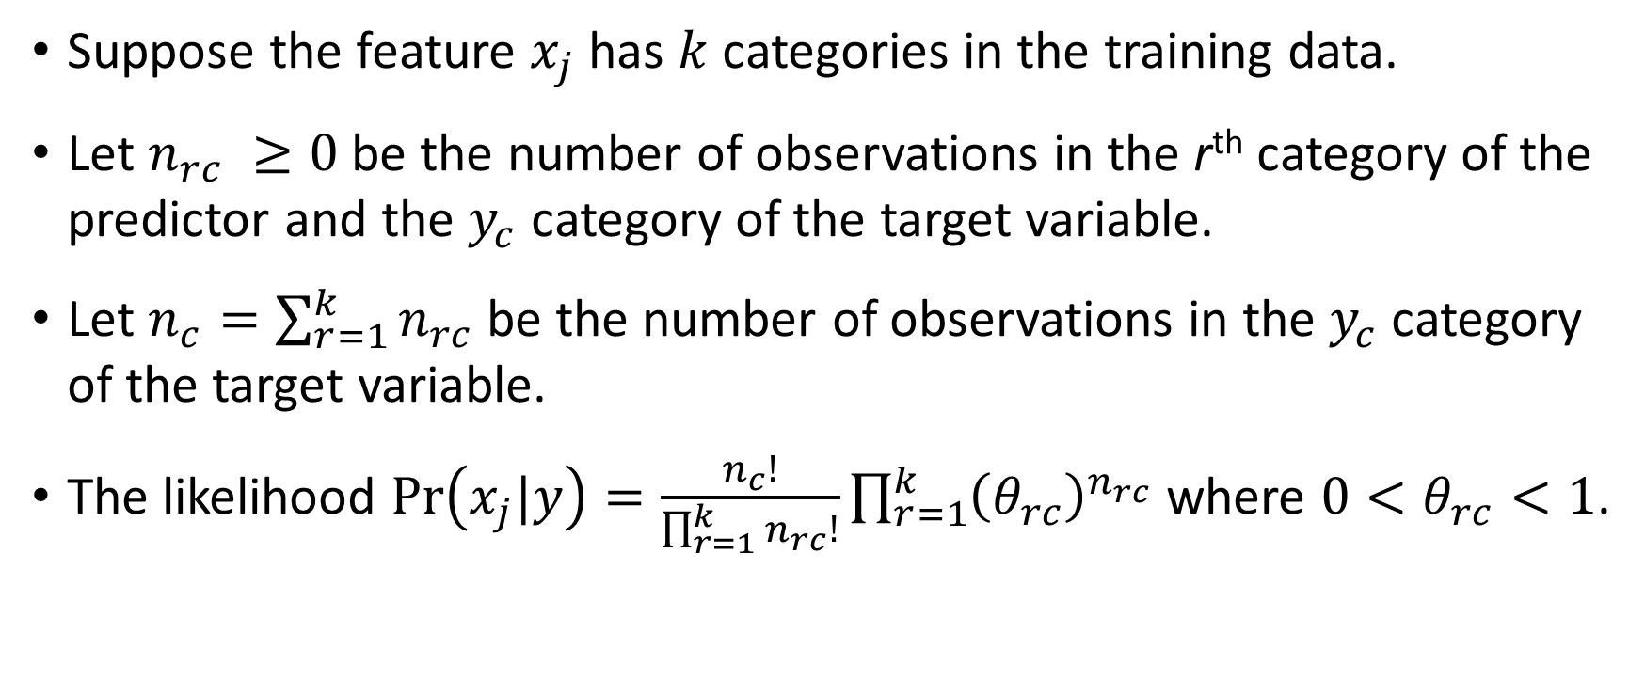
Multinomial Naïve Bayes
Suppose the feature $x_{j}$ has $k$ categories in the training data.
Let $n_{rc} ≥0$ be the number of observations in the r^{th} category of the predictor and the $y_{c}$ category of the target variable.
Let $n_{c}=\sum_{r=1}^{k}{n_{rc}}$be the number of observations in the $y_{c}$ category of the target variable.
The likelihood $Pr\left(x_{j}|y\right)=\frac{n_{c}!}{\prod_{r=1}^{k}{n_{rc}!}}\prod_{r=1}^{k}{{\left(θ_{rc}\right)}^{n_{rc}}}$ where ${0<θ}_{rc}<1$.

Slide 67
Multinomial Naïve Bayes: Smoothing Alpha
Naturally, we estimate $θ_{rc}$ by the relative frequencies as $θ_{rc}={n_{rc}}/{n_{c}}$
Naturally, we estimate 𝜃_𝑟𝑐 by the relative frequencies as 𝜃_𝑟𝑐=𝑛_𝑟𝑐∕𝑛_𝑐
If the r^{th} category of the feature is not observed in the $y_{c}$ category of the target variable, then $n_{rc}=0$ and the natural estimate $θ_{rc}=0$
If the r^{th} category of the feature is not observed in the 𝑦_𝑐 category of the target variable, then 𝑛_𝑟𝑐=0 and the natural estimate 𝜃_𝑟𝑐=0
Any $θ_{rc}=0$ will make the likelihood zero, and thus spoil all the calculations
Any 𝜃_𝑟𝑐=0 will make the likelihood zero, and thus spoil all the calculations

Slide 68
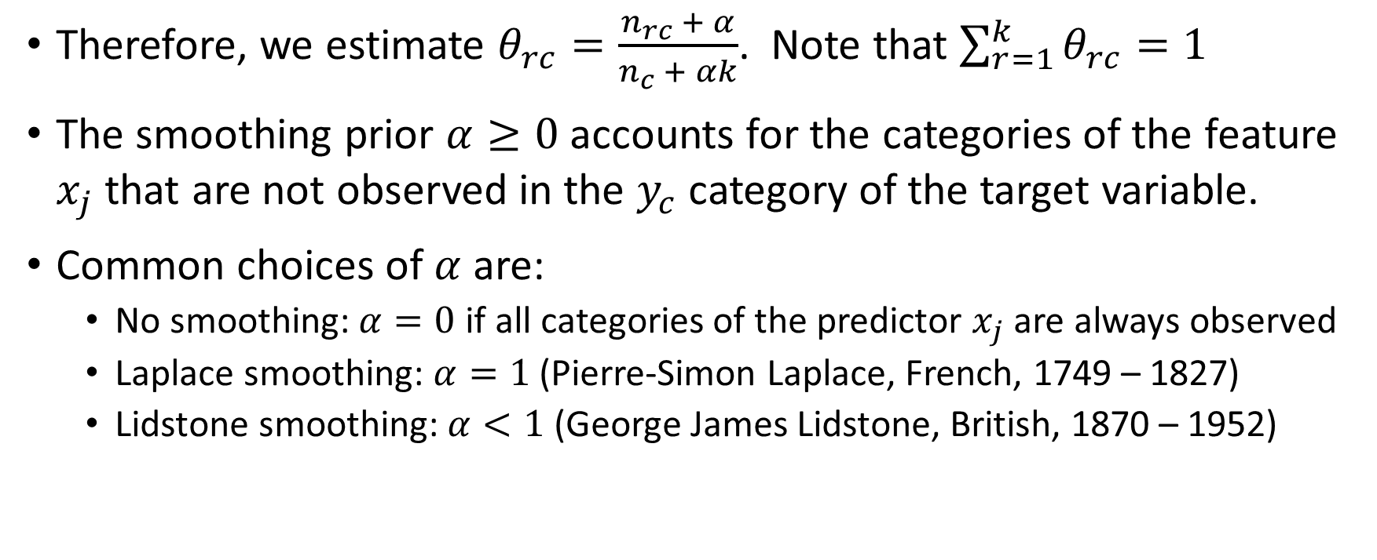
Multinomial Naïve Bayes: Smoothing Alpha
Therefore, we estimate $θ_{rc}=\frac{n_{rc} + α}{n_{c} + αk}$. Note that $\sum_{r=1}^{k}{θ_{rc}}=1$
The smoothing prior $α≥0$ accounts for the categories of the feature $x_{j}$ that are not observed in the $y_{c}$ category of the target variable.
Common choices of $α$ are:
No smoothing: $α=0$ if all categories of the predictor $x_{j}$ are always observed
Laplace smoothing: $α=1$ (Pierre-Simon Laplace, French, 1749 – 1827)
Lidstone smoothing: $α<1$ (George James Lidstone, British, 1870 – 1952)

Slide 69
Multinomial Naïve Bayes: Text Analysis
 | ID | Words in Document | City in China?
Training | 1 | Chinese Beijing Chinese | Yes
 | 2 | Chinese Chinese Shanghai | Yes
 | 3 | Chinese Macao | Yes
 | 4 | Tokyo Japan Chinese | No
Testing | 5 | Chinese Chinese Chinese Tokyo Japan | ?
 | 6 | Beijing Shanghai Macao | ?
Determine if the document contains the name of a Chinese city
Reference: https://nlp.stanford.edu/IR-book/html/htmledition/naive-bayes-text-classification-1.html
Week 10 Chinese City Naive Bayes.py

Slide 70
Multinomial Naïve Bayes: Text Analysis
 | ID | Words in Document | City in China?
Training | 1 | Chinese Beijing Chinese | Yes
 | 2 | Chinese Chinese Shanghai | Yes
 | 3 | Chinese Macao | Yes
 | 4 | Tokyo Japan Chinese | No
Six Features that indicate the number of times a word appeared.
The features are: How Often <word> appear in the document?
The word: (1) Chinese, (2) Beijing, (3) Shanghai, (4) Macao, (5) Tokyo, and (6) Japan

Slide 71
Multinomial Naïve Bayes: Text Analysis
(1) Chinese, (2) Beijing, (3) Shanghai, (4) Macao, (5) Tokyo, and (6) Japan
import numpy
import pandas
import sklearn.naive_bayes as naive_bayes
X = numpy.array([[2,1,0,0,0,0],
[2,0,1,0,0,0],
[1,0,0,1,0,0],
[1,0,0,0,1,1]])
y = numpy.array([1,1,1,0])
classifier = naive_bayes.MultinomialNB().fit(X, y)
print('Class Count:\n', classifier.class_count_)
print('Log Class Probability:\n', classifier.class_log_prior_ )
print('Feature Count (after adding alpha):\n', classifier.feature_count_)
print('Log Feature Probability:\n', classifier.feature_log_prob_)
Week 9 Chinese City Naive Bayes.py

Slide 72
Multinomial Naïve Bayes: Text Analysis
Since three out of four documents have positive identification, the class probabilities are
Negative: Pr(y = 0) = 1/4 = 0.25.
Positive: Pr(y = 1) = 3/4 = 0.75
The natural logarithm of these probabilities are
Negative: ln(Pr(y = 0)) = ln(0.25) = -1.38629436
Positive: ln(Pr(y = 1)) = ln(0.75) = -0.28768207
Class Count:
[1. 3.]
Log Class Probability:
[-1.38629436 -0.28768207]

Slide 73
Multinomial Naïve Bayes: Text Analysis
Count the number of occurrences of each word by identification result.
X = numpy.array([[2,1,0,0,0,0], [2,0,1,0,0,0], [1,0,0,1,0,0], [1,0,0,0,1,1]])
Identification Result | Chinese | Beijing | Shanghai | Macao | Tokyo | Japan
Negative (y = 0) | 1 | 0 | 0 | 0 | 1 | 1
Positive (y = 1) | 5 | 1 | 1 | 1 | 0 | 0

Slide 74
Multinomial Naïve Bayes: Text Analysis
Specify alpha = 1. Thus, add one to each cell of the table
Before
After
Identification Result | Chinese | Beijing | Shanghai | Macao | Tokyo | Japan
Negative (y = 0) | 1 | 0 | 0 | 0 | 1 | 1
Positive (y = 1) | 5 | 1 | 1 | 1 | 0 | 0
Identification Result | Chinese | Beijing | Shanghai | Macao | Tokyo | Japan
Negative (y = 0) | 2 | 1 | 1 | 1 | 2 | 2
Positive (y = 1) | 6 | 2 | 2 | 2 | 1 | 1

Slide 75
Multinomial Naïve Bayes: Text Analysis
Calculate the probability of each word, by Identification Result
Table
Result
Identification Result | Chinese | Beijing | Shanghai | Macao | Tokyo | Japan | Total
Negative (y = 0) | 2 | 1 | 1 | 1 | 2 | 2 | 9
Positive (y = 1) | 6 | 2 | 2 | 2 | 1 | 1 | 14
Identification Result | Chinese | Beijing | Shanghai | Macao | Tokyo | Japan
Negative (y = 0) | 2/9 | 1/9 | 1/9 | 1/9 | 2/9 | 2/9
Positive (y = 1) | 6/14 | 2/14 | 2/14 | 2/14 | 1/14 | 1/14

Slide 76
Multinomial Naïve Bayes: Text Analysis
Natural logarithm of the probabilities, by Identification Result
The probability
The natural logarithm of the probability
Identification Result | Chinese | Beijing | Shanghai | Macao | Tokyo | Japan
Negative (y = 0) | 2/9 | 1/9 | 1/9 | 1/9 | 2/9 | 2/9
Positive (y = 1) | 6/14 | 2/14 | 2/14 | 2/14 | 1/14 | 1/14
Identification Result | Chinese | Beijing | Shanghai | Macao | Tokyo | Japan
Negative (y = 0) | -1.5041 | -2.1972 | -2.1972 | -2.1972 | -1.5041 | -1.5041
Positive (y = 1) | -0.8473 | -1.9459 | -1.9459 | -1.9459 | -2.6391 | -2.6391

Slide 77
Multinomial Naïve Bayes: Text Analysis
The natural logarithm of the probability
Identification Result | Chinese | Beijing | Shanghai | Macao | Tokyo | Japan
Negative (y = 0) | -1.5041 | -2.1972 | -2.1972 | -2.1972 | -1.5041 | -1.5041
Positive (y = 1) | -0.8473 | -1.9459 | -1.9459 | -1.9459 | -2.6391 | -2.6391
Log Feature Probability:
[[-1.5040774 -2.19722458 -2.19722458 -2.19722458 -1.5040774 -1.5040774 ]
[-0.84729786 -1.94591015 -1.94591015 -1.94591015 -2.63905733 -2.63905733]]

Slide 78
Multinomial Naïve Bayes: Text Analysis
Given the number of occurrences of the words, what is the likelihood of a positive identification?
 | ID | Words in Document | City in China?
Training | 1 | Chinese Beijing Chinese | Yes
 | 2 | Chinese Chinese Shanghai | Yes
 | 3 | Chinese Macao | Yes
 | 4 | Tokyo Japan Chinese | No

Slide 79
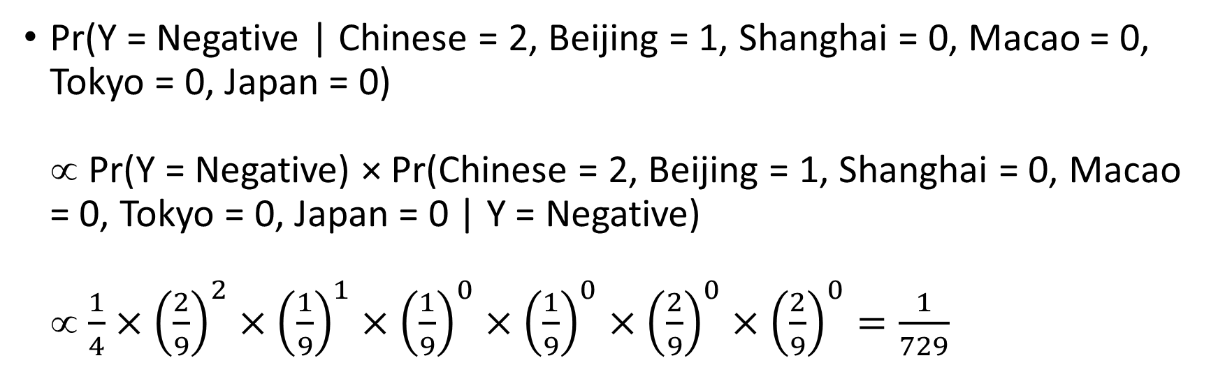
Multinomial Naïve Bayes: Text Analysis
Pr(Y = Negative | Chinese = 2, Beijing = 1, Shanghai = 0, Macao = 0, Tokyo = 0, Japan = 0) ∝ Pr(Y = Negative) × Pr(Chinese = 2, Beijing = 1, Shanghai = 0, Macao = 0, Tokyo = 0, Japan = 0 | Y = Negative) ∝ $\frac{1}{4}×{\left(\frac{2}{9}\right)}^{2}×{\left(\frac{1}{9}\right)}^{1}×{\left(\frac{1}{9}\right)}^{0}×{\left(\frac{1}{9}\right)}^{0}×{\left(\frac{2}{9}\right)}^{0}×{\left(\frac{2}{9}\right)}^{0}=\frac{1}{729}$
Identification Result | Chinese | Beijing | Shanghai | Macao | Tokyo | Japan
Negative (y = 0) | 2/9 | 1/9 | 1/9 | 1/9 | 2/9 | 2/9
Positive (y = 1) | 6/14 | 2/14 | 2/14 | 2/14 | 1/14 | 1/14

Slide 80
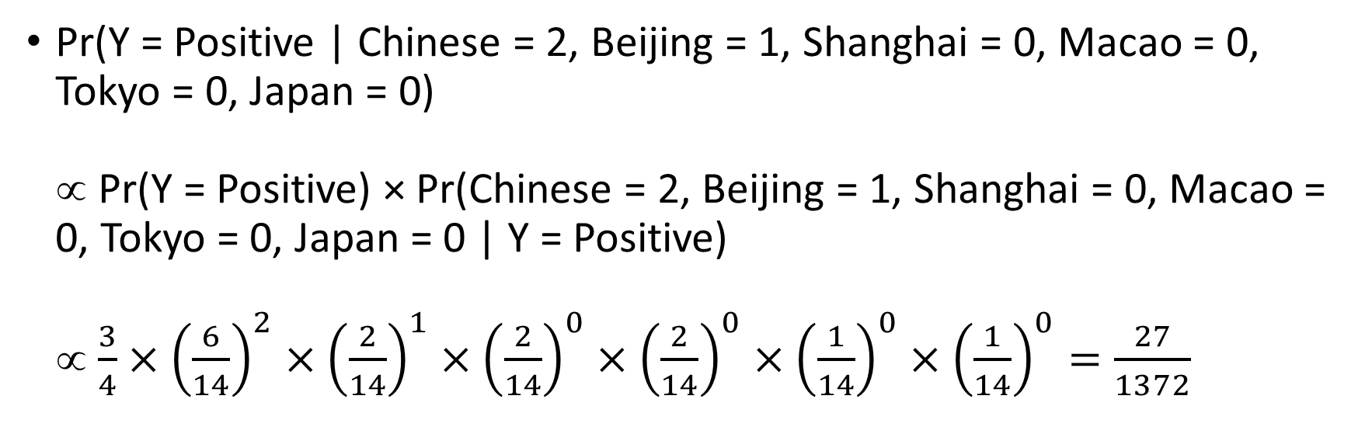
Score First Document in Training
Pr(Y = Positive | Chinese = 2, Beijing = 1, Shanghai = 0, Macao = 0, Tokyo = 0, Japan = 0) ∝ Pr(Y = Positive) × Pr(Chinese = 2, Beijing = 1, Shanghai = 0, Macao = 0, Tokyo = 0, Japan = 0 | Y = Positive) ∝ $\frac{3}{4}×{\left(\frac{6}{14}\right)}^{2}×{\left(\frac{2}{14}\right)}^{1}×{\left(\frac{2}{14}\right)}^{0}×{\left(\frac{2}{14}\right)}^{0}×{\left(\frac{1}{14}\right)}^{0}×{\left(\frac{1}{14}\right)}^{0}=\frac{27}{1372}$
Identification Result | Chinese | Beijing | Shanghai | Macao | Tokyo | Japan
Negative (y = 0) | 2/9 | 1/9 | 1/9 | 1/9 | 2/9 | 2/9
Positive (y = 1) | 6/14 | 2/14 | 2/14 | 2/14 | 1/14 | 1/14

Slide 81
Multinomial Naïve Bayes: Text Analysis
For the first document in Training,
Pr(Y = Negative | Chinese = 2, Beijing = 1, Shanghai = 0, Macao = 0, Tokyo = 0, Japan = 0) ∝ 1/729
Pr(Y = Positive | Chinese = 2, Beijing = 1, Shanghai = 0, Macao = 0, Tokyo = 0, Japan = 0) ∝ 27/1372
Final step is to rescale these two values such that the resulting values add up to one.
Pr(Y = Negative | Chinese = 2, Beijing = 1, Shanghai = 0, Macao = 0, Tokyo = 0, Japan = 0) = (1/729) / (1/729 + 27/1372) = 0.06516267
Pr(Y = Positive | Chinese = 2, Beijing = 1, Shanghai = 0, Macao = 0, Tokyo = 0, Japan = 0) = (27/1372) / (1/729 + 27/1372) = 0.93483733

Slide 82
Multinomial Naïve Bayes: Text Analysis
Predicted Probabilities for all the documents
 | ID | Words in Document | City in China? | Pr(Positive|Dcoument) | Pr(Negative|Document)
Training | 1 | Chinese Beijing Chinese | Yes | 0.93483733 | 0.06516267
 | 2 | Chinese Chinese Shanghai | Yes | 0.93483733 | 0.06516267
 | 3 | Chinese Macao | Yes | 0.88149940 | 0.11850060
 | 4 | Tokyo Japan Chinese | No | 0.37412328 | 0.62587672
Testing | 5 | Chinese Chinese Chinese Tokyo Japan | Yes | 0.68975861 | 0.31024139
 | 6 | Beijing Shanghai Macao | No | 0.33878380 | 0.66121620
Predicted Conditional Probability (Training): [[0.06516267 0.93483733]
[0.06516267 0.93483733]
[0.1185006 0.8814994 ]
[0.62587672 0.37412328]]
Predicted Conditional Probability (Testing):
[[0.31024139 0.68975861]
[0.6612162 0.3387838 ]]

Slide 83
Lecture Recap
Introduced to Directed Acyclic Graph (DAG) and Bayesian Network
Understood Naïve Bayes’ Algorithms
Target is always Categorical
Features can be
Categorical and Binary in particular
Continuous
Multinomial

